Slide 1
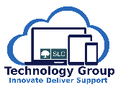
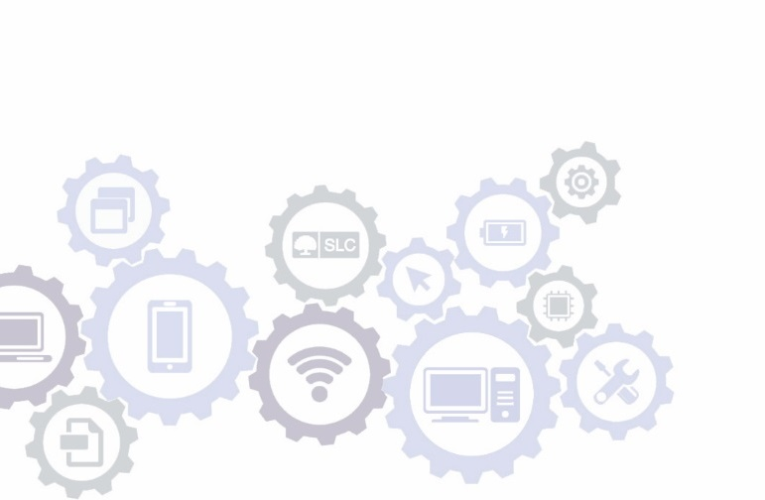

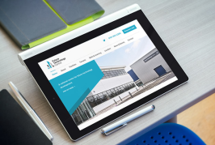



Cloud Engineering Team
Cloud and PaaS Project Briefing
16 July 2019
Bob Lowndes, Naga Kishan

Slide 2
Contents
Introduction and Objectives for Today
The Cloud and PaaS Project – Outcomes
Application Architectures On-prem and Cloud
Accounts
The Landing Zone
AWS – SLC Interconnectivity
Security Considerations
Support Implications of Cloud-hosted model
Metrics, Monitoring and Logging
Release, Change and Service Management
CMS Migration – before and after
Summary

Slide 3
1. Introduction and Objectives for Today
Objectives for the Day:
This session is primarily aimed at colleagues who are currently not directly working on Cloud projects to provide:
An Overview of the Cloud and PaaS Project – what it is and why?
Share the Aims of the Cloud Engineering Team – who, what?
Show the different Application Delivery Models in the Cloud - and how they may be used
Present the high-level structure of accounts and technology at AWS
Review Plans and Status of the first Cloud Migration - CMS

Slide 4
2.1 Cloud and PaaS Project - Objectives
We do not want to simply move our existing applications and structure across to AWS – the primary driver is not just shutting down our datacentres and replacing with AWS datacentres.
1. Buy rather than Build – Overall TG Strategy Directive
2. Benefit from the Flexibility and Agility available at AWS:
Very quick build / set-up times
Ability to switch-on / switch-off based on need
Ability to scale up and down quickly and automatically
No delay between developers needing new environments and them being available
Choice | Solution | Examples
1 | SaaS - Software as a Service | WorkDay, SalesForce, etc
2 | PaaS - Platform as a Service | AWS Oracle RDS, Mongo Atlas, S3
3 | IaaS - Infrastructure as a Service | AWS EC2
4 | All on-prem - entire stack | Assure

Slide 5
2.2 Cloud and PaaS Project - Objectives
3. Self-service capabilities
Ability to use self-service functions to reduce dependency on central teams
Allows / supports greater autonomy of Delivery Teams
4. Built-in Disaster Recovery
Use of AWS availability zones
Applications can be deployed across multiple physically separate datacentres
All taken care of seamlessly without intervention
5. Maximise the use of AWS Managed Services
Choice | Solution
1 | AWS Lambda - Serverless
2 | AWS Fargate – AWS Managed servers, Fargate containers
3 | AWS Docker – Docker Containers
4 | EC2 Instances – standard application deployment

Slide 6
2.2 Cloud and PaaS Project - Objectives
3. Self-service capabilities
Ability to use self-service functions to reduce dependency on central teams
Allows / supports greater autonomy of Delivery Teams
4. Built-in Disaster Recovery
Use of AWS availability zones
Applications can be deployed across multiple physically separate datacentres
All taken care of seamlessly without intervention
5. Maximise the use of AWS Managed Services
Choice | Solution
1 | AWS Lambda - Serverless
2 | AWS Fargate – AWS Managed servers, Fargate containers
3 | AWS Docker – Docker Containers
4 | EC2 Instances – standard application deployment
Model Selected for CMS

Slide 7
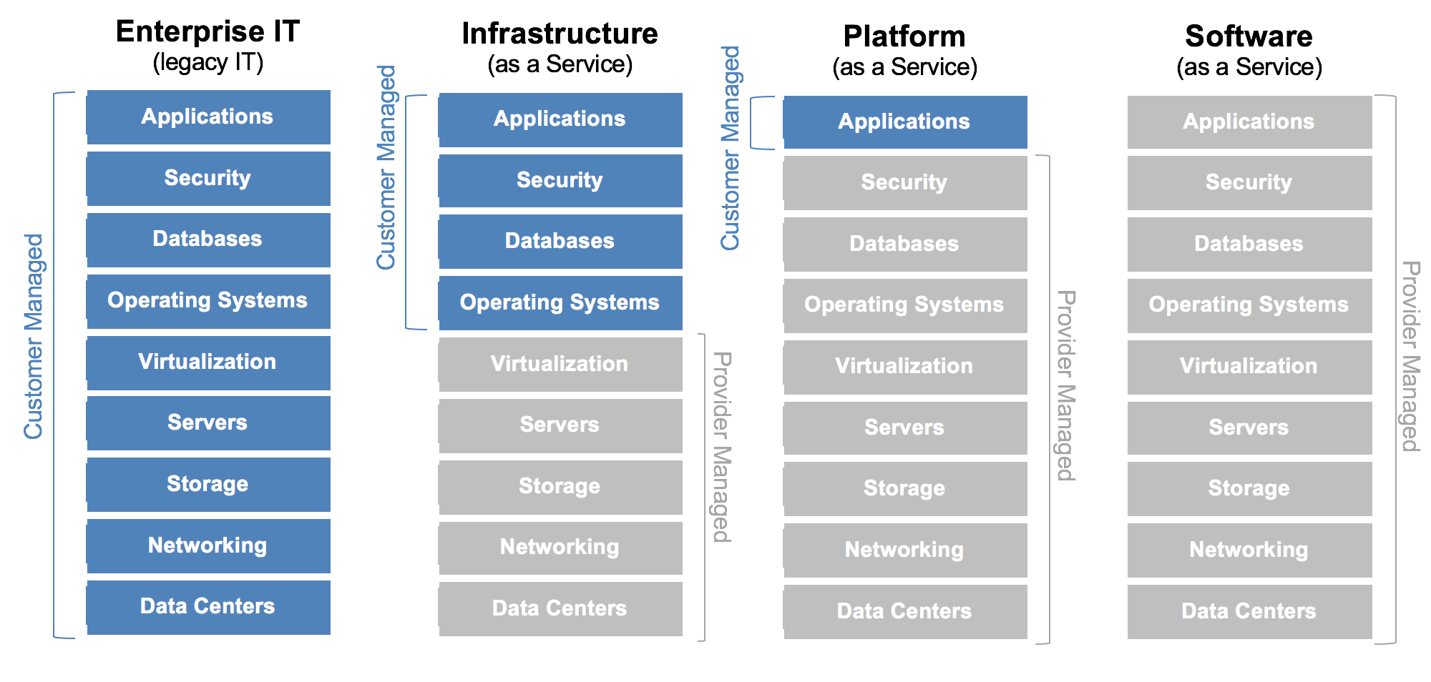
2.3 Buy rather than Build

Slide 8
3. Application Architectures and the Cloud

Slide 9
3.1 Platform Delivery Patterns – an example MongoDB
Example - Patterns for a MongoDB platform:
MongoDB – on-prem
MongoDB – lift and shift to AWS (IaaS)
AWS DocumentDB (PaaS)
Mongo Atlas (PaaS)

Slide 10
MongoDB – On Premise
Use Cases
If the application using this database is hosted on-premise, you would normally host the database on-premise to reduce latency between the app and database.
As we manage our on-premise equipment you can also host this on-premise if you need to retain a certain amount of control over other PaaS solutions.
Implementation Guide
Application/Engineering team requests a server via Passport.
Engineering team deploys a new replica set via OpsManager.
Application team deploys their data to the MongoDB databases.

Slide 11
MongoDB – Lift and Shift (AWS EC2)
Use Cases
If the application that will be using the database is hosted on AWS, you may want to host MongoDB on AWS to reduce latency.
You can also use this pattern if the PaaS solution that is offered does not support certain requirements and you may need additional control which PaaS does not offer.
Implementation Guide
Application/Engineering team requests a server via AWS console or Terraform.
Engineering team deploys a new replica set via OpsManager.
Application team deploys their data to the MongoDB databases.

Slide 12
MongoDB – AWS DocumentDB (not yet available UK)
Use Cases
If your application is hosted on AWS.
You want to reduce operational costs by letting AWS manage more of the ‘stack’ or you want to use as many PaaS offerings as possible.
Implementation Guide
Application/Engineering team to deploy new DocumentDB cluster via AWS console or Terraform.
Application team deploys MongoDB data to DocumentDB.

Slide 13
MongoDB – Atlas
Use Cases
Your application is hosted in the cloud either on AWS, Azure, or Google Compute.
You require 100% MongoDB compatibility which DocumentDB does not offer.
You want to reduce operational costs by giving Atlas more control over the ‘stack’.
Implementation Guide
Application/Engineering team deploys a new Mongo Atlas cluster via the Atlas control panel.
Application team to deploy MongoDB data to new cluster.

Slide 14
4.1 AWS Accounts
Accounts:
The SLC overall AWS account is sub-divided into a number of accounts.
Overall management of the SLC Master account rests with Cloud Engineering (billing, access, etc)
There are effectively two types of account:
Permanent Accounts – Master, Security, Transit, Logging – that are always in place
Delivery Accounts – where we build systems etc. These can be further sub-divided as:
Line-of-Business (LoB) accounts – eg. CMS, Customer Portal, Repayment Portal, etc etc
Test accounts – test lab, ad-hoc temporary dev accounts, Proof of Concept (PoC) accounts etc
New Stand-alone Systems – eg. UserIM account

Slide 15
4.2 Accounts and Billing
There will be one invoice per month for SLC.
This will be broken down by each Account and by different services we have used.
We have the ability to further sub-divide by associating tags with individual systems, environments, etc – as suits our needs.
So, for example, we could charge-back costs for DEV, NT, ST, OAT type environments to the projects that are driving development/releases but charge all LIVE environments to BAU.
For overheads shared across projects and BAU we could choose to apportion these across projects and BAU.
So, the output would be:
An AWS monthly invoice
A separate breakdown showing how this should be apportioned to projects and BAU
AWS provide a management interface that allows us to track our costs and forecast end-of-month invoice as we progress through the month
We have the ability to set-up billing alerts to control / monitor usage/costs.
Cost are also controlled at the “front-door” by restricting/controlling which services can be consumed.

Slide 16
5.1 Accounts and the Landing Zone
The Landing Zone:
The Landing Zone delivers the following concepts:
It is responsible for setting up the Delivery Account
Creates necessary links to other permanent accounts (security, transit)
Puts billing rules in places
Sets up account user administration
Builds the infrastructure (VPCs, subnets, routing, ACLs, Security Group) for the various environments
Effectively, everything that then allows developers to build their applications safely and efficiently
The Landing Zone comprises a set of Terraform script that add-in the new delivery account.

Slide 17
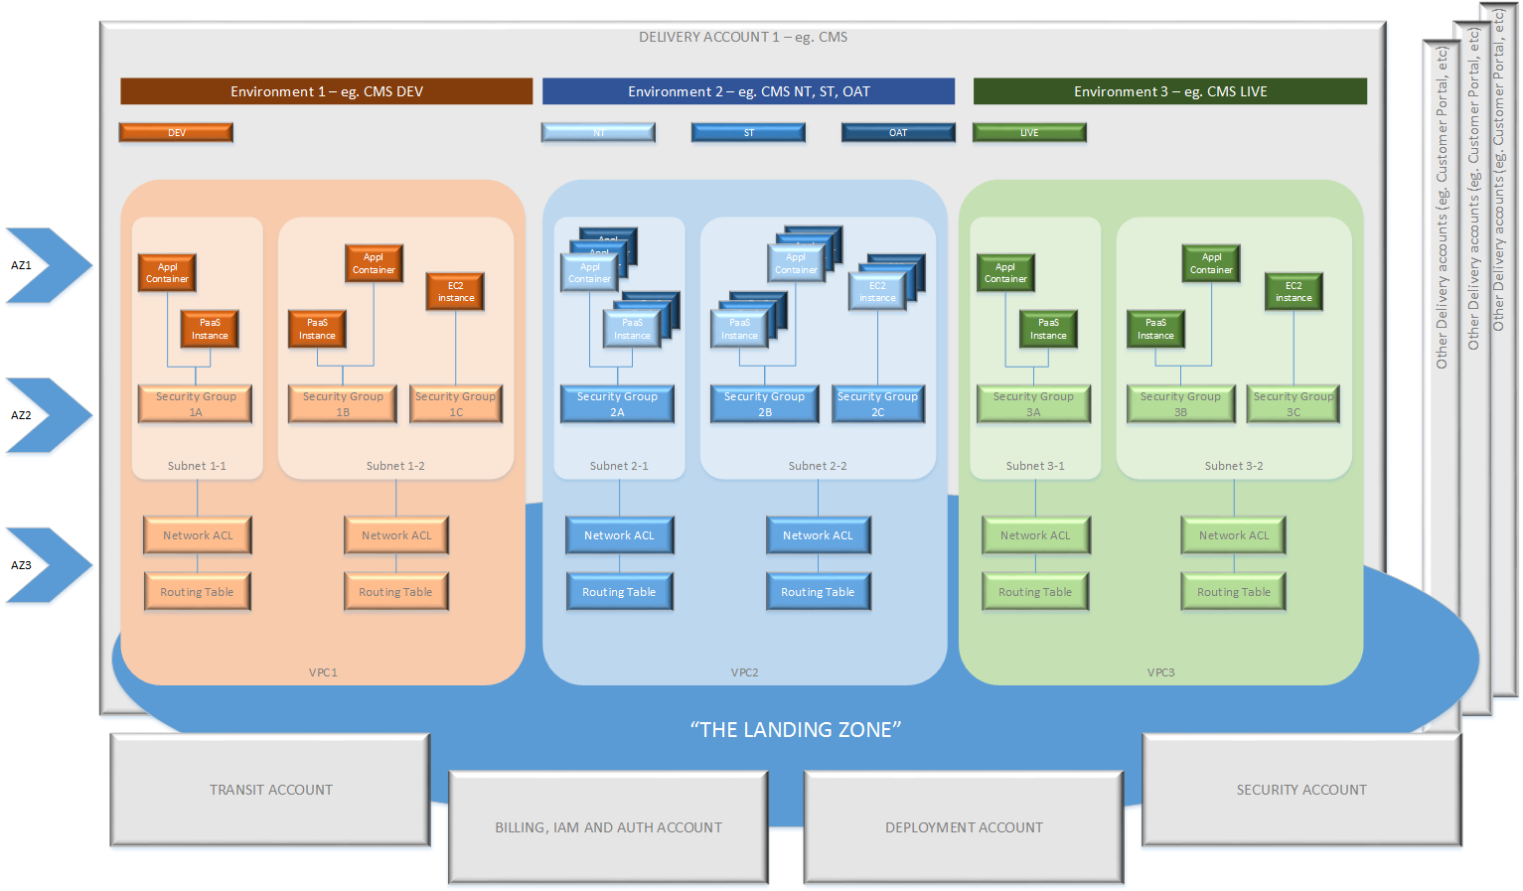
5.2 Account Building and the Landing Zone

Slide 18
5.3 Landing Zone
Master Account
Transit Account
Security Account
Cloud9
Deployment Accounts

Slide 19
5.4 The Landing Zone (Step-By-Step Outcome of Terraform Script)
Terraform code is applied using Cloud9 IDE.
Terraform code will build VPC resources, and DNS for the Deployment accounts (i.e. Testlab1).
Creates a transit gateway attachments on the transit account for the new test account.
Squid proxy are running on Ec2 with Auto Scaling group on Transit accounts
SNS Services topic is created and email subscription is added for the user’s email.
Security services below are attached with the main Security account and invitations will be send to deployed accounts and invitation should be accepted on the Deployments accounts side for the following services.
After this first stage , Main Resources for application can be managed according to the needs of the project and the resources for new accounts are now restricted to eu-west 2 (London).
3x Availability Zones (Datacentres) in UK London (eu-west-2) Region.
Security Hub
AWS_Config
Guardduty

Slide 20
6. AWS – SLC Interconnectivity

Slide 21
7. Security Considerations
AWS/Cloud provides a number of opportunities for Security team including:
Start to move from Detective to Preventative Control
Potential for automated incident remediation
Move in the direction of built-in Security by Design (rather than bolt-on later)
Better visibility
Better monitoring tools available
Better standardisation of applications – consistency is the friend of security
Less moving parts – more focused at application layer and less infrastructure to manage (complexity is enemy of security?)
Building scanning policies into build pipelines
Remove need to patch layers of infrastructure removes significant risk
Greater automation / codification serves Security needs
Initially:
The Landing Zone process includes basic security rules and processes that are then applied to new accounts (including ACLs and Security Groups)
Security team are investigating various tools for applicability and usage in AWS including CloudTrail, CloudWatch, AWS Shield, AWS WAF etc

Slide 22
8. Support Implications of Cloud-hosted model
There are a number of factors at play that will mean we need to adapt / adjust our support model:
There will be much more infrastructure that we no longer need to manage.
The focus will shift from managing infrastructure to managing applications.
There will be additional tools available at AWS to help us manage / monitor our systems
The move to the cloud and the extra agility / self-service capabilities may mean we move more towards a “you build it, you support it” model.
However:
We still own the Business Services that we deliver to our customers (external and internal)
We still own the responsibility for delivering the agreed service levels (SLAs)
We will have solutions that span AWS <-> internal for years to come.
We still need monitoring, alerting, incident management, problem management, service reporting etc etc that need to be consistent across AWS/internal systems.

Slide 23
9. Logging, Monitoring and Metrics
Terminology:
Monitoring – real-time, live health checks / status checks on system that can generate an immediate alert
Metrics – usually time-based data for system (CPU, memory etc) or on application (messages sent, number of page hits, number of student applications, etc etc)
Logging – collect system and application logs, send to central system, search and filter for different conditions, potentially use to raise alerts or to analyse offline.
Internal Tools and Processes:
We have a number of tools internally including SCOM, Icinga, Graphite, Grafana and the ELK stack.
Already looking to bring these together and look to get a consistent view across NOC, support teams, application teams.
The move to the cloud and the extra agility / self-service capabilities may mean we move more towards a “you build it, you support it” model.
AWS Tools:
The problem space is reduced in that AWS will manage a greater proportion of the estate – we can’t monitor servers if we don’t have any!
CloudWatch, CloudTrails and AWS Xray.
Bottom line is we still need to integrate back to our own Business Service view – AWS will not be managing CMS.

Slide 24
10. Release, Change and Service Management
Key Impacts of hosting at AWS:
The problem space is smaller – less moving parts, less infrastructure, more components are managed by AWS. This must have an immediate beneficial impact.
This does, however, introduce a dependency on the service relationship with AWS – and monitoring them, holding to account, sharing data, service reporting, notifications of their changes, etc.
As with monitoring and metrics, the business services and appropriate levels of governance are SLC not AWS issues.
Hence, top-level Service Management, Change, Release processes may remain unchanged as these relate more directly to our Business Services and our Applications.
However, there is a trend already towards “You build it, you support it” and whilst this is not new to SLC, hosting at AWS may accelerate this.
This could push us more in a direction of Standard Changes and in the direction of release automation but that is already part of the journey.

Slide 25
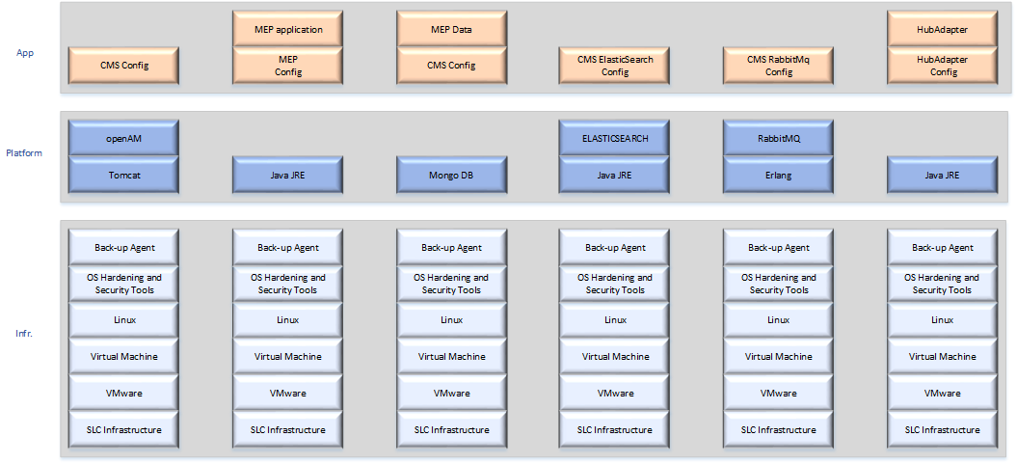
11. CMS Migration
Current

Slide 26
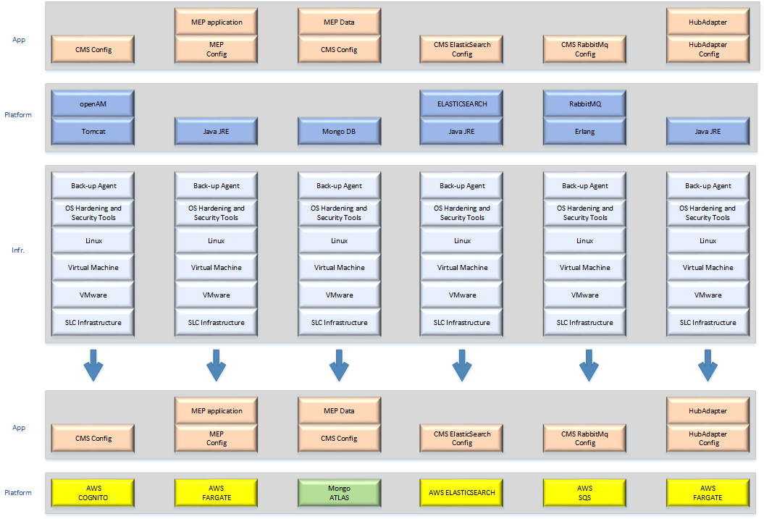
11. CMS Migration
Current
Future

Slide 27
11. CMS Migration – before

Slide 28
11.1 .CMS Proposed (Dev) Architecture (Multi-AZ High Availability)

Slide 29
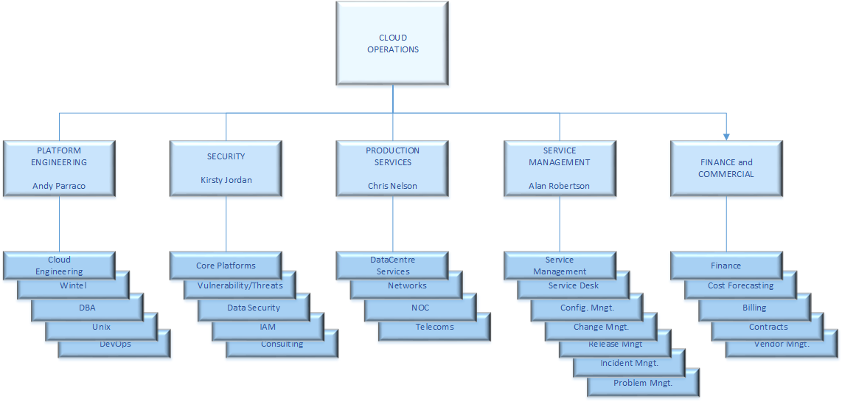
12. Cloud Operations

Slide 30
13. Follow-up
Feel free to contact members of the Cloud Engineering team – Andy Parraco, Bob Lowndes, Naga Kishan
More Technical Deep-dive if needed
We are planning a “drop-in” afternoon for demonstrations, Q&A, etc

